Slide 1




Slide 2


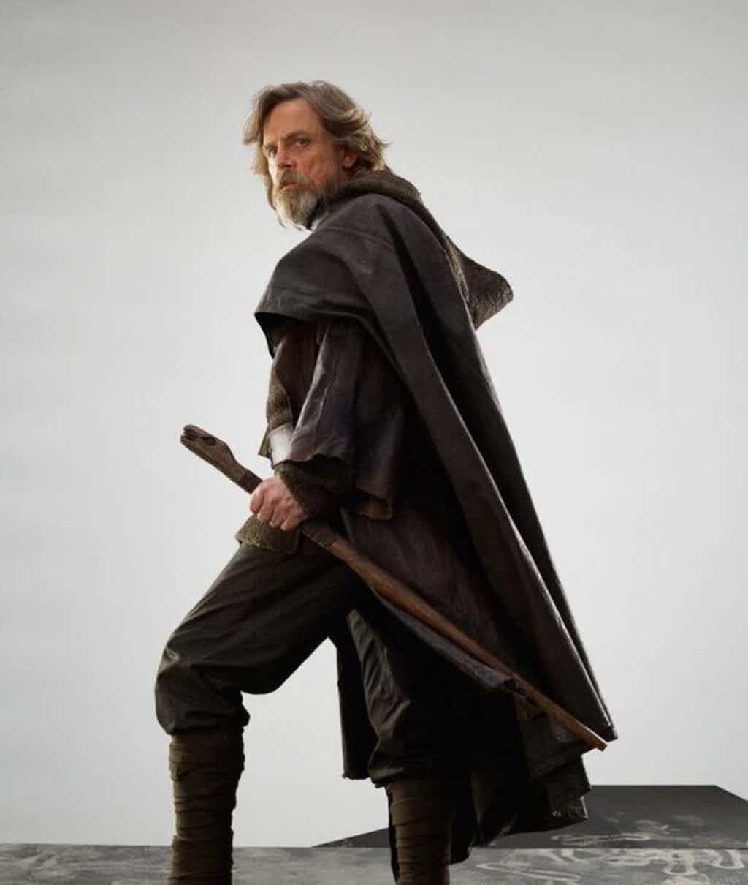

Slide 3
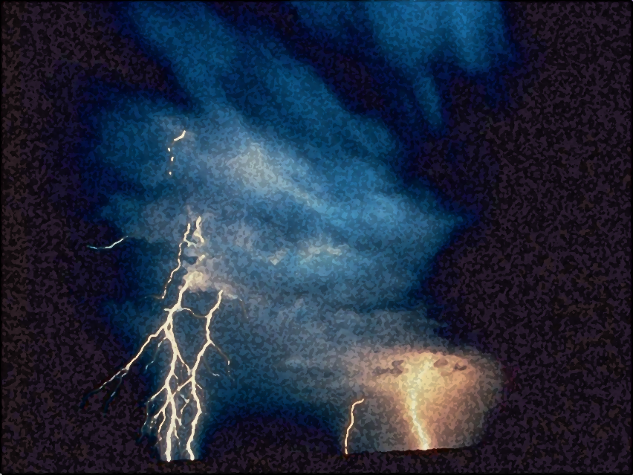

Light out of Darkness
The Vision of Isaiah
Doom to Bloom

Slide 4


The Vision of Isaiah
How to become a useful, faithful and righteous servant of God.
A Call to Servanthood
How does sinful Israel become servant Israel?

Slide 5
The Vision of Isaiah
The entire book is an appeal to abandon human pride, to trust in the LORD, accept His lordship, and to experience all of life as it was originally meant to be - a reflection of God’s holy image and the role of a servant upon the earth.

Slide 6
The Vision of Isaiah
Introduction:
The Present and Future of God’s People
1:1 – 5:30

Slide 7
The Vision of Isaiah
A Call
to Servanthood
6:1-13

Slide 8
The Vision of Isaiah
Whom Shall We Trust?
The Basis
of Servanthood
7:1 – 39:8

Slide 9
The Vision of Isaiah
Chapters 1-5 are a powerful, though general statement of the hopes and realities of Judah’s situation. The section moves back and forth between the two themes of doom and deliverance.

Slide 10
The Vision of Isaiah
Chapter 1
Introduces the Introduction
“The Grand Arraignment”
The Charge:
“Abandoning the LORD”
“Idolatry”

Slide 11
Chapter 1
Sets the Stage for What Follows
Declares the inevitable destructive results of forsaking God
The foolishness of rote religion
The necessity of justice
The corruption of leadership
Through it all the possibility of redemption, return and restoration.

Slide 12
The Vision of Isaiah
God’s Denunciation, Plea, and Promise
1:2-31

Slide 13
The Vision of Isaiah
Denunciation – 1:2-9
God’s charge against Israel: She has forsaken the LORD and is as a result,
broken and desolate.

Slide 14
The Vision of Isaiah
Plea – 1:10-20
God’s plea for Israel to hear, receive instruction, and to take the only reasonable action: obedience and submission.

Slide 15
Listen, Learn, and Live
“If you are willing and obedient, you shall eat the good of the land; But if you refuse and rebel, you shall be devoured by the sword’; For the mouth of the LORD has spoken.” (1:19-20)
Ignore, Ignorance, and Death

Slide 16
Listen, Learn, and Live
Promise – 1:21-31
God’s promise of judgment (death) for rebels and sinners, or redemption (life) for repentant ones.
Ignore, Ignorance, and Death

Slide 17
Listen, Learn, and Live
“Zion shall be redeemed with justice, and her penitents with righteousness. The destruction of transgressors and of sinner… and those who forsake the LORD shall be consumed.” (1:27-28)
Ignore, Ignorance, and Death

Slide 18
The Vision of Isaiah
The Problem:
What Israel Is
Versus
What Israel Will Be 2:1 – 4:6

Slide 19
The Vision of Isaiah
The Problem:
Sinful Israel
Versus
Servant Israel
2:1 – 4:6

Slide 20
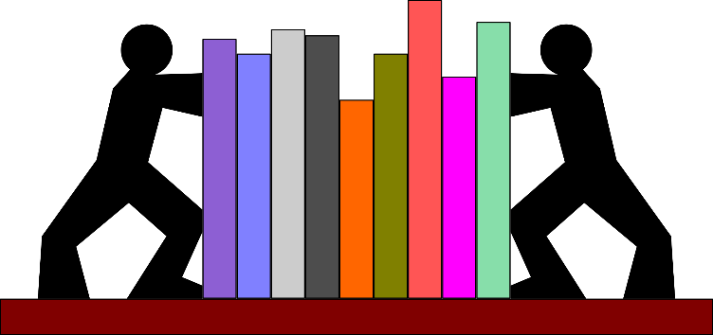
The Vision of Isaiah
Destiny of the House of Jacob
2:1-5
House of Jacob Forsaken
2:6 – 4:1
Israel Restored
4:2-6
“will be”
“is”
“will be”

Slide 21
The Vision of Isaiah
Destiny of the House of Jacob
2:1-5
House of Jacob Forsaken
2:6 – 4:1
Israel Restored
4:2-6
“ideal”
“real”
“ideal”

Slide 22
The Vision of Isaiah
Israel can only fulfill the destiny given to her in 2:2-4 by experiencing the judgment expressed throughout 2:6 – 4:1 and the purification described in 4:2-6.

Slide 23
The Vision of Isaiah
“proud self-sufficient Israel can become the witness to the greatness of God only when she has been reduced to helplessness by his just judgment and then restored to life by his unmerited grace.” (Oswalt, p. 113)

Slide 24
The Vision of Isaiah
The Destiny of the House of Jacob
2:1-5
“what will be”
Notes:
Isaiah 2:1-5
“The word that Isaiah the son of Amoz saw concerning Judah and Jerusalem. Now it shall come to pass in the latter days that the mountain of the LORD's house shall be established on the top of the mountains, and shall be exalted above the hills; and all nations shall flow to it. Many people shall come and say, "Come, and let us go up to the mountain of the LORD, to the house of the God of Jacob; He will teach us His ways, and we shall walk in His paths." For out of Zion shall go forth the law, and the word of the LORD from Jerusalem. He shall judge between the nations, and rebuke many people; they shall beat their swords into plowshares, and their spears into pruning hooks; Nation shall not lift up sword against nation, neither shall they learn war anymore. O house of Jacob, come and let us walk in the light of the LORD.”

Slide 25
The Vision of Isaiah
The Destiny of the House of Jacob
2:1-5
“the mountain of the LORD, … the God of Jacob”

Slide 26
The Mountain of God
“The word that Isaiah the son of Amoz saw concerning Judah and Jerusalem.” (2:1)
Another Superscription
Used to introduce an independent prophetic saying or a collection of sayings

Slide 27
The Mountain of God
“The word that Isaiah the son of Amoz saw concerning Judah and Jerusalem.” (2:1)
Another Superscription
It signals the beginning of specific prophecies after the introduction.

Slide 28
The Mountain of God
“The word that Isaiah the son of Amoz saw concerning Judah and Jerusalem.” (2:1)
Another Superscription
It applies to chapters 2-5 with the understanding that a new group of sayings begins at chapter 6.

Slide 29
The Mountain of God
Isaiah 2:2-4
An abrupt shift in mood
“A Shock Prophet”
Rebellion to Restoration
Notes:
“The main focus of attention was upon Israel’s rebellion, hypocrisy, and injustice. Suddenly here, with no transition at all, the focus is upon Israel’s glorious destiny as a lighthouse to the nations for truth and peace.” So, what happened?” Will God merely forget Israel? Is He going to let them get away with it? How can Israel become that Israel?

Slide 30
The Mountain of God
Isaiah 2:2-4
Almost word for word of Micah 4:1-3
“from the mouth of the LORD”

Slide 31
The Mountain of God
Isaiah 2:2-4
It Fulfills Two Functions
It emphasizes the certainty of Israel’s Destiny
It’s Motivational
Notes:
“Whatever the present may be, however grim the immediate future may be, the distant future signals the Judeans to live in its certainty.
What could convince the present Judeans to live lives of faithfulness and righteousness? Not so much the threat of punishment as the promise of greatness. And what could convince coming generations that the destructive lash under which the bow is, indeed, not their final dissolution but to their restoration? It is the conviction/belief that they exist not merely as another nation but in order that the nations might be redeemed.” (Oswalt, p. 116)

Slide 32
The Mountain of God
“Now it shall come to pass in the latter days that the mountain of the LORD's house shall be established on the top of the mountains, and shall be exalted above the hills; And all nations shall flow to it.” (2:2)
Notes:
After the day of retribution and judgment, when all false hopes of human greatness apart from God have been dashed to pieces, God will restore His people. God’s final purpose is not destruction or alienation. Rather, God’s coming day would only be complete when cleaning and restoration has taken place.

Slide 33
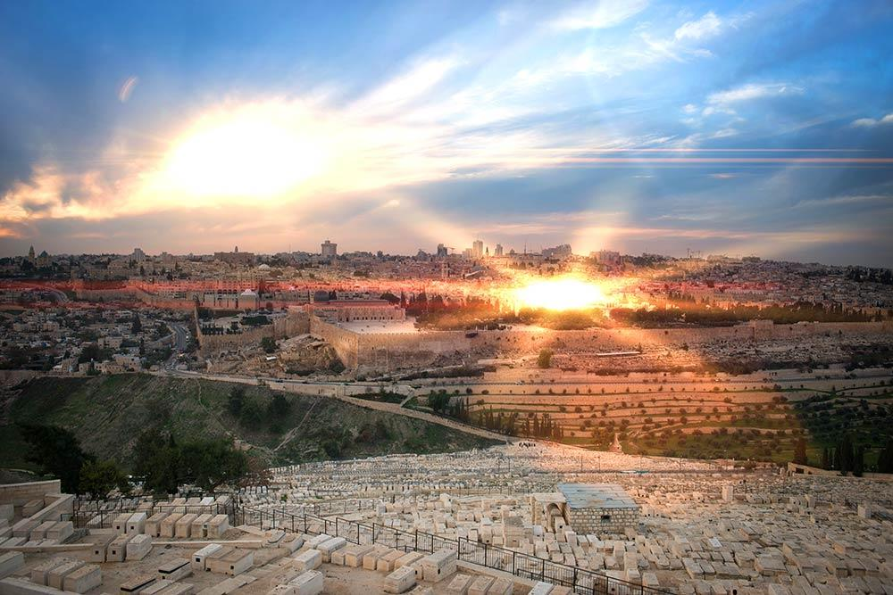
The Mountain of God
“Many people shall come and say,
‘Come, and let us go up to the mountain of the LORD, to the house of the God of Jacob…” (2:3a)

Slide 34
The Mountain of God
“He will teach us His ways, and we shall walk in His paths.’ For out of Zion shall go forth the law, and the word of the LORD from Jerusalem.” (2:3b)
Notes:
“This is the purpose of judgment and of redemption, that people should be like God. “Be ye holy as I am Holy”

Slide 35
The Mountain of God
“Now it shall come to pass in the latter days…”
The “latter days” is the future.
When?
The Millennial Age or Beyond
Post-Exile or the Church Age

Slide 36
The Mountain of God
“Now it shall come to pass in the latter days…”
The “latter days” is the future.
When?
Literal or Figurative

Slide 37
The Mountain of God
“Now it shall come to pass in the latter days…”
The “latter days” is the future.
When?
Post-Exile – Did Not Happen!
Israel was despised by all.

Slide 38
The Mountain of God
“Now it shall come to pass in the latter days…”
The “latter days” is the future.
When?
Church Age – Is it Happening?
Partial fulfillment – Here, Not Yet

Slide 39
The Mountain of God
“For from the rising of the sun, even to its going down, My name shall be great among the Gentiles… For I am a great King,’ Says the LORD of hosts, ‘And My name is to be feared among the nations.” (Malachi 1:11a, 14b)

Slide 40
The Mountain of God
“…And all nations shall flow to it.”
When?
When did unbelievers ever flock to church?
Entertainment, Attractions, Gimmicks, Trickery
Notes:
The church usually has to beg people to come.

Slide 41
The Mountain of God
“…And all nations shall flow to it.”
When?
The church age believers are told to go unto the nations… we should not expect them to flock to the church to be taught the ways of God.
Notes:
The church usually has to beg people to come.

Slide 42
The Mountain of God
“…And all nations shall flow to it.”
When?
Their has not been a partial fulfillment, so its fulfillment is still in the Millennial future and beyond.
Notes:
The church usually has to beg people to come.

Slide 43
The Mountain of God
“He will teach us His ways, and we shall walk in His paths…’
The coming is for the purpose of being taught, and the being taught is for the purpose of walking, that is, living
= discipleship.

Slide 44
The Mountain of God
“He will teach us His ways, and we shall walk in His paths…’
Listen, Learn and Live

Slide 45
The Mountain of God
“For out of Zion shall go forth the instruction, and the word of the LORD from Jerusalem.”
Jerusalem has become a symbol of God’s self-revelation through-out history.

Slide 46
The Mountain of God
“For out of Zion shall go forth the instruction, and the word of the LORD from Jerusalem.”
There are not many ways to God, only one way. And there is no life apart from Him who has revealed Himself supremely.

Slide 47
The Mountain of God
“He shall judge between the nations, and rebuke many people; They shall beat their swords into plowshares, and their spears into pruning hooks. Nation shall not lift up sword against nation, neither shall they learn war anymore.” (2:4)
Notes:
“Isaiah sees hope through the very punishment for sin. The fiery judgment would be the factor in the cleansing process.” “…the purgative fire is a gift of God. It is through suffering that growth is most often achieved.

Slide 48
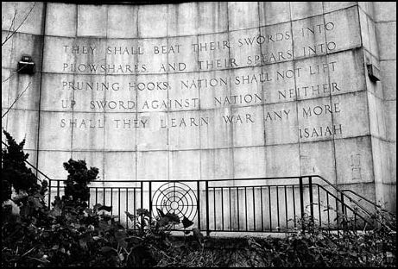
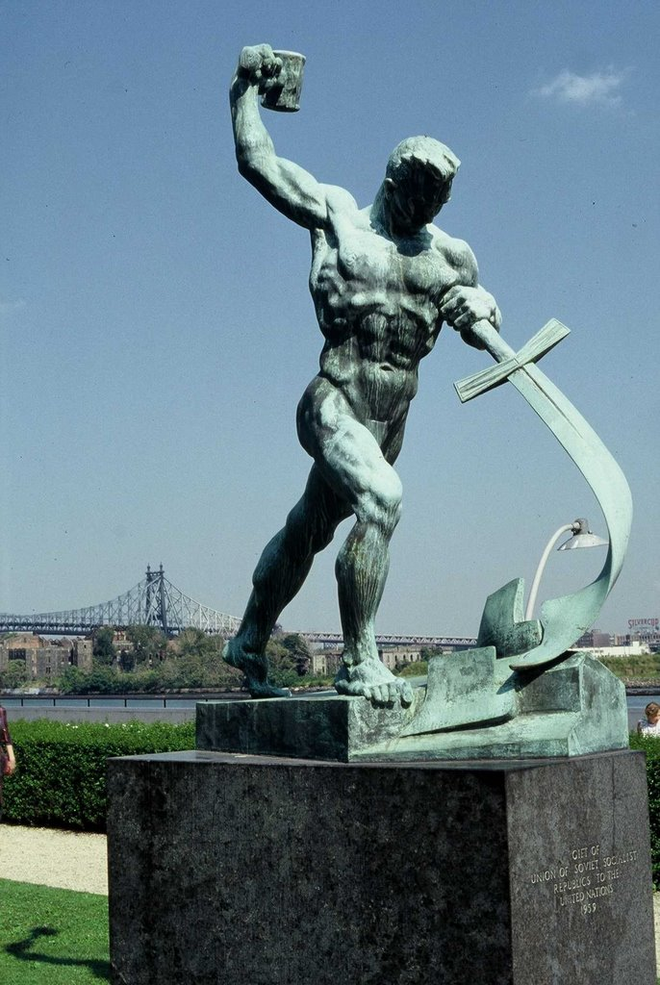
The Mountain of God
United Nations, NYC

Slide 49
The Mountain of God
“Come and see the works of the LORD, the desolations he has brought on the earth. He makes wars cease to the ends of the earth; He breaks the bow and shatters the spear, He burns the shields with fire.” (Ps. 46:8-9) (NIV)

Slide 50
The Mountain of God
“In that day I will make a covenant for them with the beasts of the field and the birds of the air and the creatures that move along the ground. Bow and sword and battle I will abolish from the land, so that all may lie down in safety.” (Hos. 2:18) (NIV)

Slide 51
The Mountain of God
“The LORD has spoken. Proclaim this among the nations: Prepare for war! Rouse the warriors! Let all the fighting men draw near and attack. Beat your plowshares into swords and your pruning hooks into spears. Let the weakling say, 'I am strong!' Come quickly, all you nations from every side, and assemble there.” (Joel 3:8-11) (NIV)

Slide 52
The Mountain of God
“I will take away the chariots from Ephraim and the war-horses from Jerusalem, and the battle bow will be broken. He will proclaim peace to the nations. His rule will extend from sea to sea and from the River to the ends of the earth.” (Zech. 9:10) (NIV)

Slide 53
The Mountain of God
“The fruit of righteousness will be peace; the effect of righteousness will be quietness and confidence forever. My people will live in peaceful dwelling places, in secure homes, in undisturbed places of rest.” (Isa. 32:17-18) (NIV)

Slide 54
The Mountain of God
“O house of Jacob, come and let us walk in the light of the LORD.” (2:5)
Peace on earth is only an illusion until people and nations come to the mountain of God to learn His ways and walk in them.

Slide 55
The Mountain of God
“O house of Jacob, come and let us walk in the light of the LORD.” (2:5)
The admonition for Israel is if the nations are to come to the light we hold, then ought we walk in that light.
Notes:
“The passage is intended to function in a motivational way, to encourage both present and future generations to leave their foolish rebellion and embrace their calling of servanthood in God.” This truth is applicable to us as well. Our future is sure and secure if we have trusted in Christ of His promise of eternal life. We must also abide in His Word to learn His ways and walk in them by His spirit. But if we abandon this path, as many have done, then a fire of discipline is what we will face.

Slide 56
The Mountain of God
Israel was not walking in that light but have forsaken God, therefore God has forsaken Israel.
“For You have forsaken Your people, the house of Jacob...” (2:6a)

Slide 57
The Mountain of God
Instead of teaching the nations God’s ways, Israel was being taught the ways of the world. They were learning dependence on human greatness, but Isaiah shows in 2:7 – 4:1 by a series of stunning contrast how such dependence does not exalt but humiliates.

Slide 58

The Mountain of God
But has God given up on His people? Is there no hope for Israel? Is her current sinful condition so great that her future destiny is beyond reach.

Slide 59

The Mountain of God
Israel Restored
4:2-6

Slide 60
The Mountain of God
“In that day the Branch of the LORD shall be beautiful and glorious; And the fruit of the earth shall be excellent and appealing for those of Israel who have escaped.” (4:2)
Notes:
After the day of retribution and judgment, when all false hopes of human greatness apart from God have been dashed to pieces, God will restore His people. God’s final purpose is not destruction or alienation. Rather, God’s coming day would only be complete when cleaning and restoration has taken place.

Slide 61
The Mountain of God
“In that day the Branch of the LORD shall be beautiful and glorious; And the fruit of the earth shall be excellent and appealing for those of Israel who have escaped.” (4:2)
Notes:
When God gives Israel glory, then she will know her true greatness., the greatness which eluded her when she sought to produce that glory herself.

Slide 62
The Mountain of God
“And it shall come to pass that he who is left in Zion and remains in Jerusalem will be called holy -- everyone who is recorded among the living in Jerusalem.” (4:3)
Notes:
“This is the purpose of judgment and of redemption, that people should be like God. “Be ye holy as I am Holy”

Slide 63
The Mountain of God
“When the Lord has washed away the filth of the daughters of Zion, and purged the blood of Jerusalem from her midst, by the spirit of judgment and by the spirit of burning,” (4:4)
Notes:
“Isaiah sees hope through the very punishment for sin. The fiery judgment would be the factor in the cleansing process.” “…the purgative fire is a gift of God. It is through suffering that growth is most often achieved.

Slide 64
The Mountain of God
“My brethren, count it all joy when you fall into various trials, knowing that the testing of your faith produces patience. But let patience have its perfect work, that you may be perfect and complete, lacking nothing.” (James 1:2-4)

Slide 65
The Mountain of God
“then the LORD will create above every dwelling place of Mount Zion, and above her assemblies, a cloud and smoke by day and the shining of a flaming fire by night. For over all the glory there will be a covering.” (4:5)
Notes:
This would help to establish a sense of continuity with the past and let them know that the searing words of judgment did not mean that God had abandon them completely, and His ancient covenant. God keeps His word! God’s ultimate intention is to share his presence with them as intimately possible. The cloud would speak of God’s care for them through protection and guidance.

Slide 66
The Mountain of God
“And there will be a tabernacle for shade in the daytime from the heat, for a place of refuge, and for a shelter from storm and rain.” (4:6)
Notes:
This is to say that nothing in he created universe can harm those who belong to God, abide with Him, and walk in His ways.

Slide 67
The Mountain of God
“He who dwells in the secret place of the Most High Shall abide under the shadow of the Almighty. I will say of the LORD, "He is my refuge and my fortress; My God, in Him I will trust.” (Psalm 91:1-2)
Notes:
Those who “abide in the shadow of the Almighty” have nothing to fear from the “principalities and powers” of this world.

Slide 68
The Vision of Isaiah

